Slide 1

CYCLIST BIKE SHARE ANALYSIS
BY
TULASSIDEVI

Slide 2
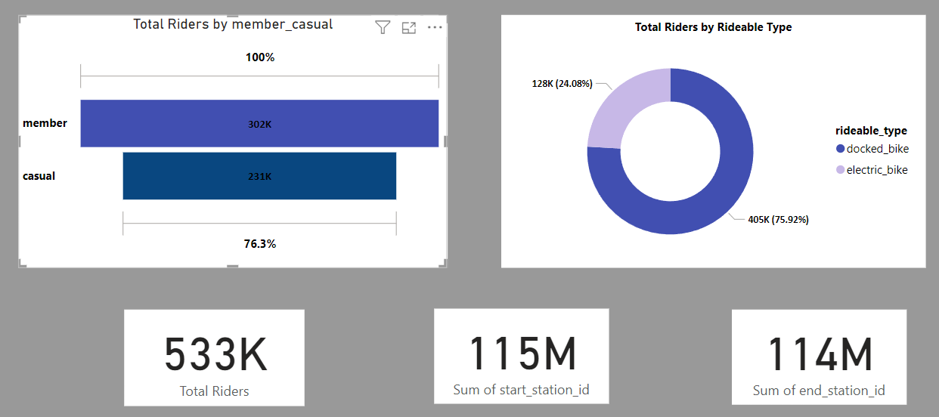
OVERVIEW PERFORMANCE
Total riders
Total start station
Total end station
Riders type

Slide 3
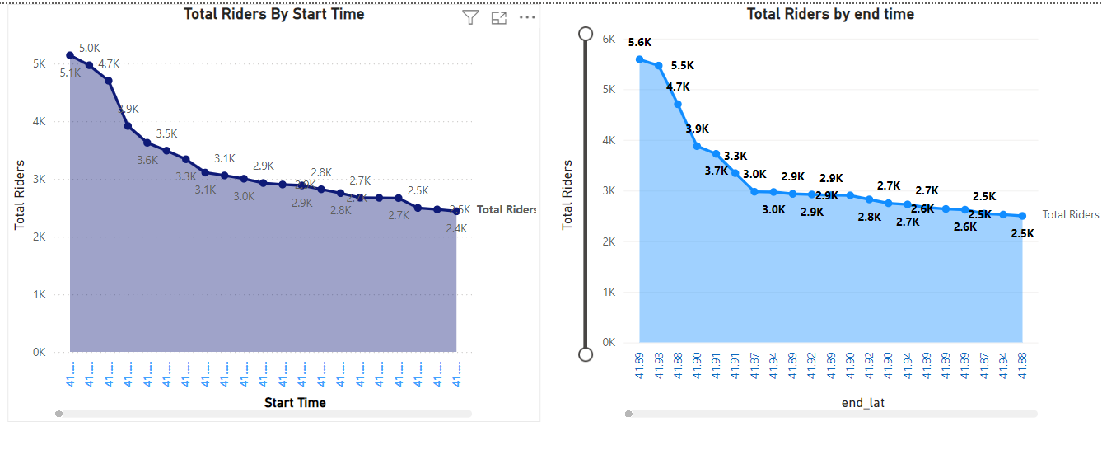
DASHBOARD ANALYSES
Start time
End time

Slide 4
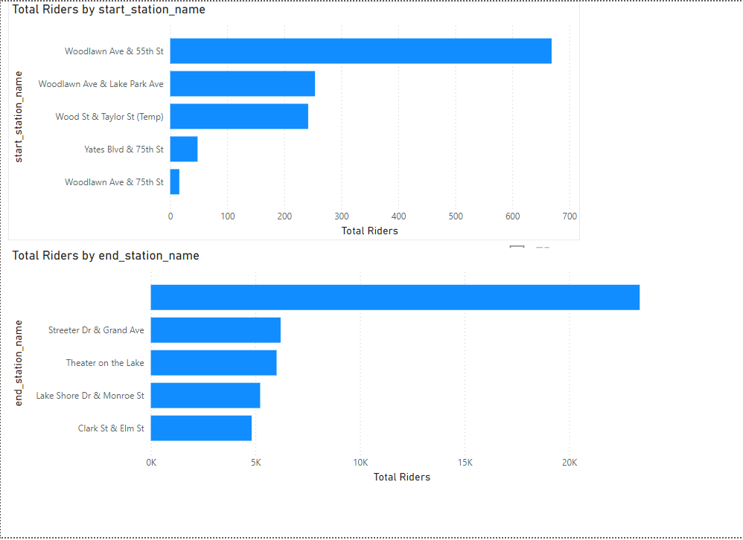
DASHBOARD ANALYSES
Top 5 starting station name
Top 5 ending station name

Slide 5
PERFORMANCE IMPROVEMENT
Overall analysis we should improve the following points:
Target audience
Lagging in which place
Safety Measure
Analysing the stations
Bicycle conditions needs to check regularly.
GPS tracking

Slide 6
THANK YOU

